Slide 1
COMPUTER CLASSIC CO., LTD.

Slide 2
Overview Company Profile
Vision and Mission
Our Success Stories
Key to success
Contact us

Slide 3
COMPUTER CLASSIC CO., LTD.
Company was established in 2013, we have been IT Support and Solutions provider for various kind of businesses all over Thailand.
Since the establishment in 2013, we provides a complete end-to-end of IT solution and services as follows:
Implementation and Installation Include Training
Onsite Repair services and Maintenance Service Agreement (MA)
Product maintenance : POS , Desktop PC , Notebook , Server , Printer , CCTV , EDC , Network & Electrical system including CCTV , Access controller and Air conditioner
Help desk support line ( Service hour: 24x7 )
Selling Computer & IT Equipment ( Dealers of The Value System and Interlink Thailand)

Slide 4
Vision
To be leading managed of IT solution and services provider in Thailand
Mission
We will challenge our skills and abilities to provide the highest quality services that consistently meet customer’s expectations

Slide 5
Installation and training of user Including Maintenance service For POS , Server , Printer , VOIP Phone and IT Equipment

Slide 6
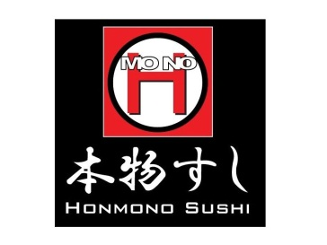
Wiring and Installation Including Maintenance service For Network & Electrical system , CCTV and Access controller

Slide 7
Installation and Maintenance service For computer & IT Equipment and System Software

Slide 8
Installation and training Including Maintenance service For Electronic Data Capture ( EDC )

Slide 9
Installation and Maintenance service For Air conditioner

Slide 10
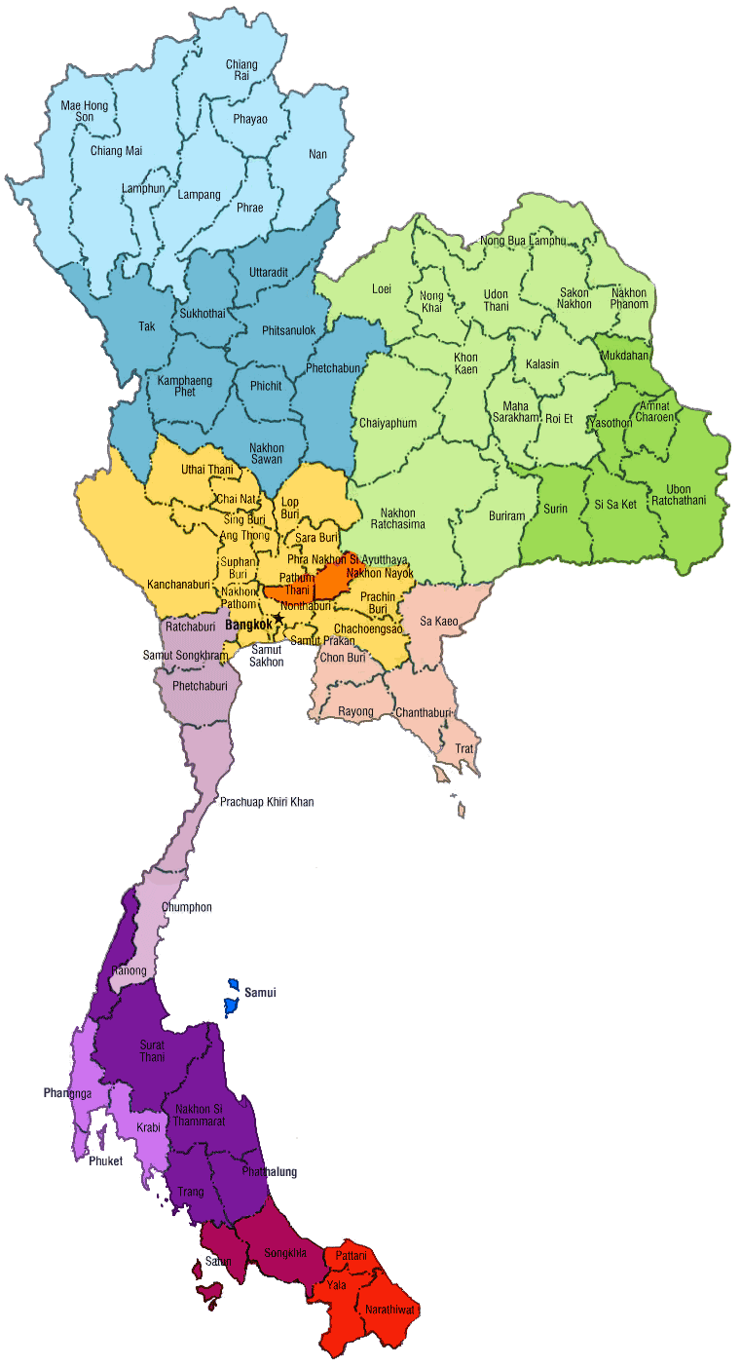
Nationwide Service Center
Chiang Rai
Lampang
Chiang Mai
Udon Thani
Khon Kaen
Sakon Nakhon
Phitsanulok
Maha Sarakham
Kamphaeng Phet
Amnat Charorn
Nakhon Sawan
Ubon
Bangkok and Central Area
( Coverlet Area 300 Km. From Service center )
Buriram
Nakhonratchasrima
39 Engineers
1 Service Center in Bangkok (Service HQ)
Existing 26 Service Centers (Work From Home) in Upcountry
Northern : 6
Southern : 8
North-East : 8
Eastern : 4
Prachin Buri
Prachuap Khiri Khan
Chonburi
Rayong
Chanthaburi
Surat Thani
Samui
Nakhon Si Thammarat
Phuket
Phatthalung
Songkhla
Pattani

Slide 11
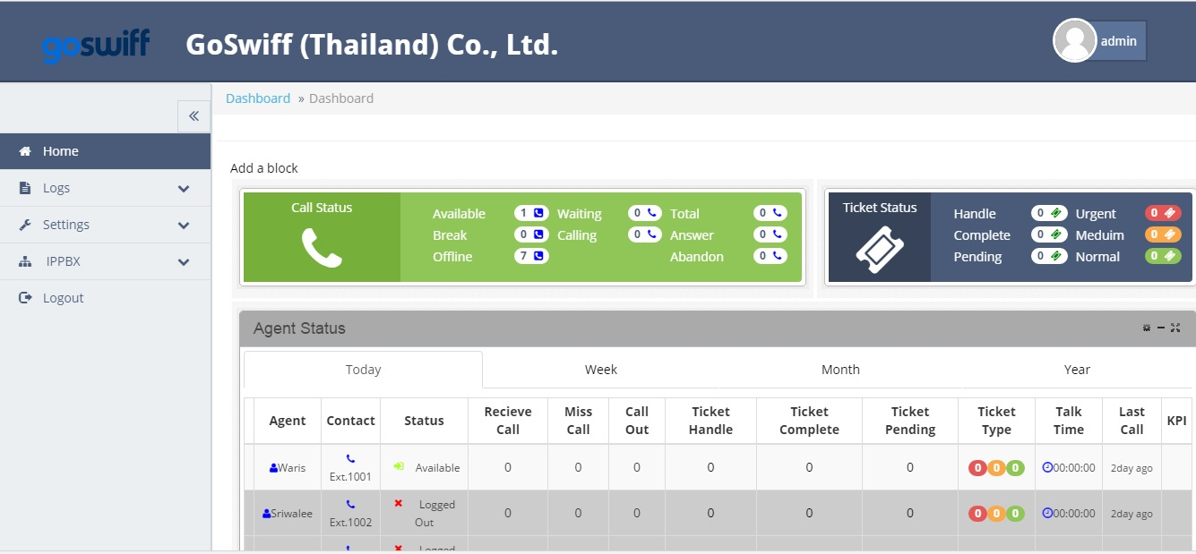
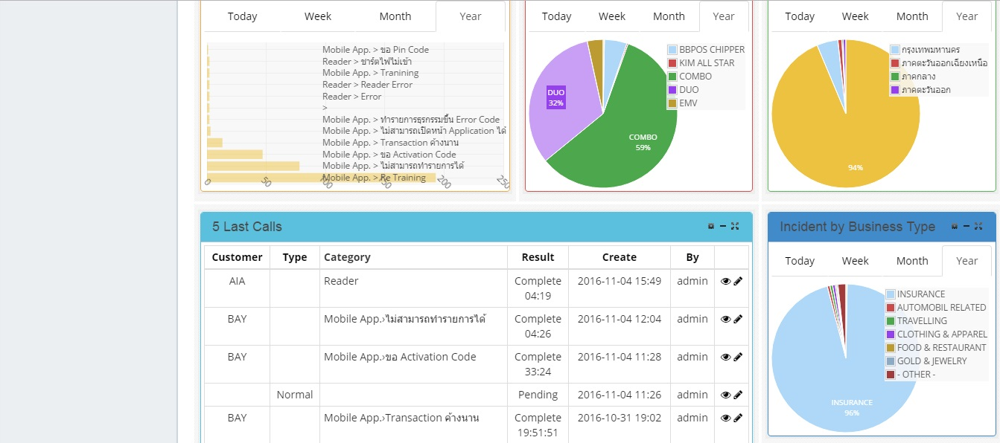
Software Management System

Slide 12
Key to success
Integrity
We believe that if it’s not good enough for us then it’s not good enough for our customers.
Passion to satisfy customer needs
Our customers are our first priority to focus on and they always deserve the best.
Respect the people
We treat our employees with respect and provide them pleasant environment to enable them sustain high motivation to deliver service to our customers.
Challenge ourselves
We believe it is essential to think big to grow big. Then, we never stop to enhance knowledge and skill for the competitive advantage in IT solution service industry.

Slide 13
COMPUTER CLASSIC CO., LTD.
Address : 5 Trok-KangRongrean Watphotinimit ,Soi Thoet Thai19 , Bang Yi Ruea, Khet Thon Buri, Bangkok 10600
Tel : 02-1143791 , 065-8987644
E-Mail : chaiyo.computerclassic@gmail.com
Facebook : https://www.facebook.com/ComputerClassic.co.th
Company Website : www.computerclassic.co.th

Slide 15
Thank you for your attention

